Slide 1

Plant Pals
Customer Survey Results
Plant Pals recently shipped test batches of plants to customers in advance of the formal service launch. To gauge customer satisfaction with the product and the service, your team surveyed 50 customers over a period of four weeks. After two weeks, the survey revealed three major issues concerning product quality, delivery timelines, and customer support. This feedback helped you make improvements to later test shipments.

Slide 2
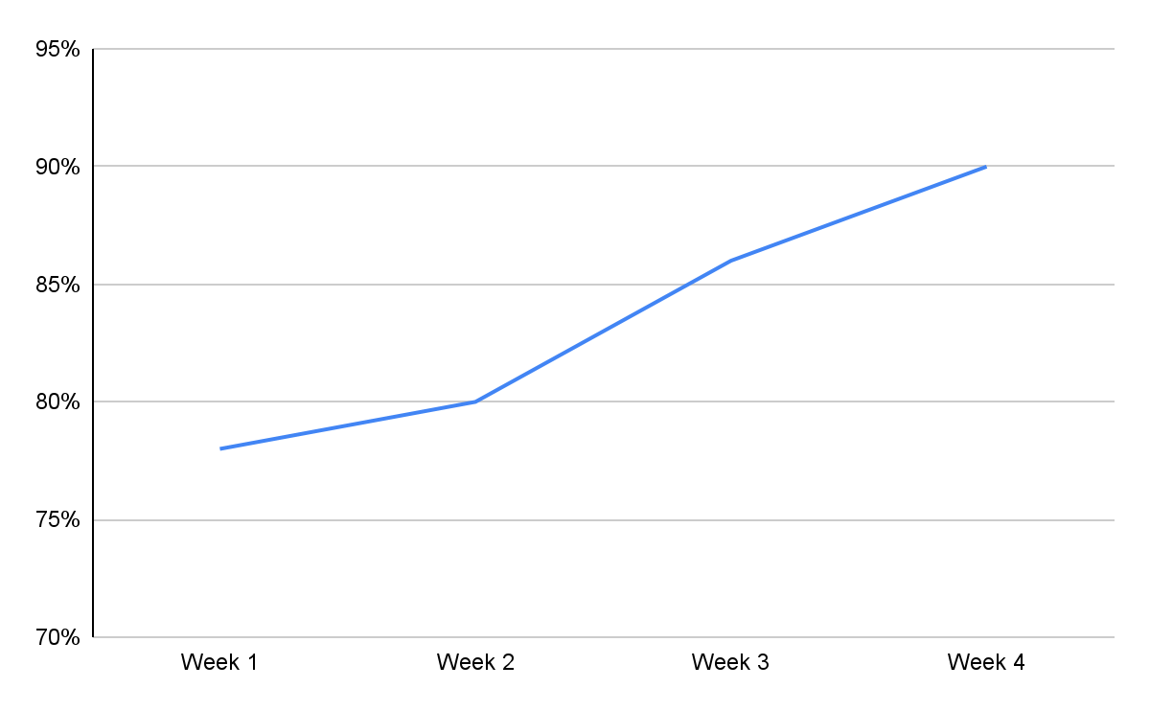
Did your shipment arrive on time?
[Insert chart or graph here]
Key takeaways & action items: On-time deliveries rose to 90% by the end of the survey - a solid improvement, but still short of our 95% target. Investigate additional reasons for delays.

Slide 3
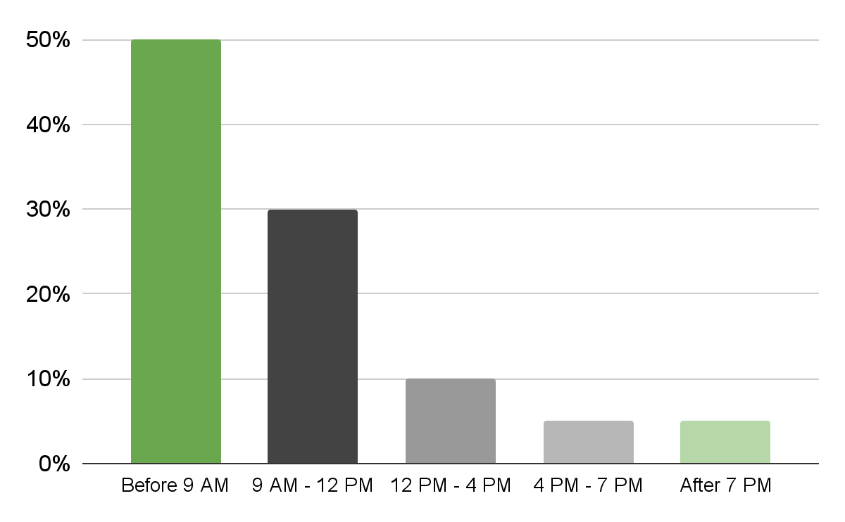
What is your preferred time of day to receive a shipment from Plant Pals?
[Insert chart or graph here]
Key takeaways & action items: 50% of customers preferred a drop-off before 9 AM. 80% before 12 PM. Consider adding more early morning routes, which could help successful, on-time deliveries to 95%.

Slide 4
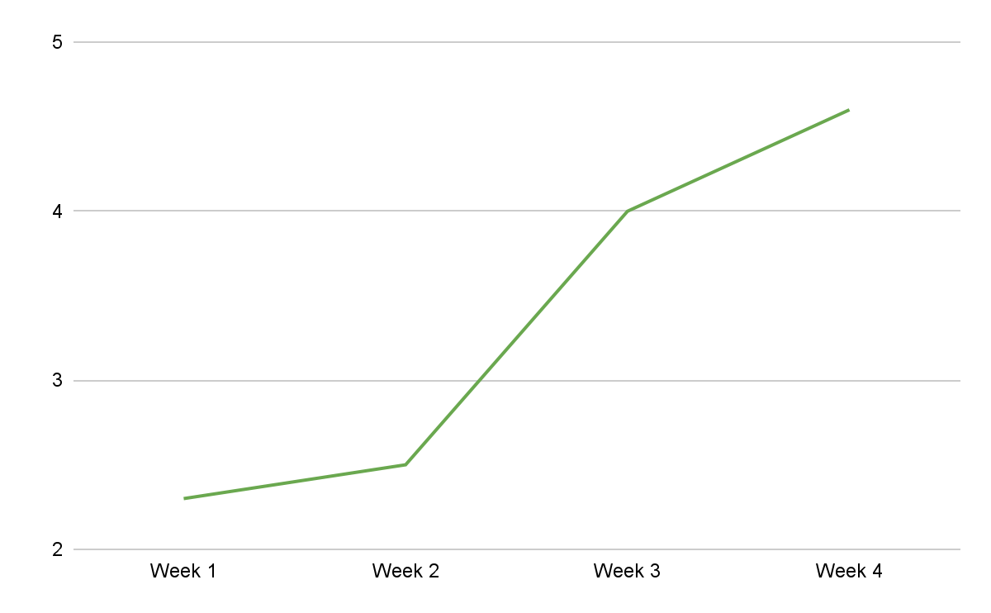
On a scale of 1 to 5, with 1 being the lowest and 5 being the highest, how satisfied are you with customer support?
[Insert chart or graph here]
Key takeaways & action items:

Slide 5
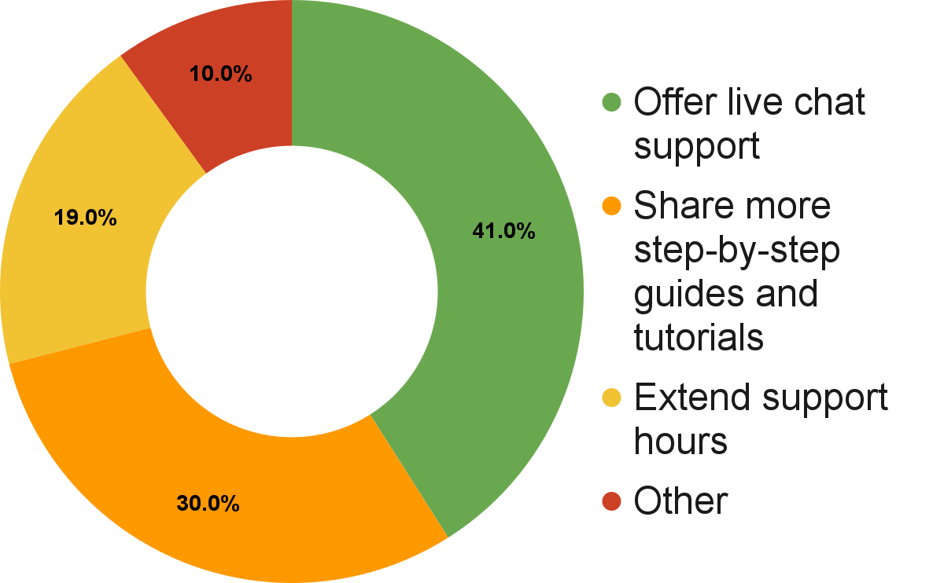
In general, how do you suggest we improve our customer support?
[Insert chart or graph here]
Key takeaways & action items: A number of customers volunteered that a live chat option would improve customer support. Also, many respondents found the guides and tutorials helpful. Research expanding these offerings for specific plant species.

Slide 6
Conclusion and next steps
Previous survey results revealed some initial issues with the test launch. The latest results indicate we have successfully addressed some of those issues:
Hiring more drivers led to a ~10% increase in on-time deliveries
Customer satisfaction increased once we resolved the known technical issues
However, there is still room for improvement. We recommend:
Focus on early deliveries to meet on-time delivery target
Customers prefer the live chat support option. Consider allocating more support resources to live chat support. Continue to create tutorials and guides for new offerings.
Continue to survey consistently and monitor results for additional improvements

